Slide 1
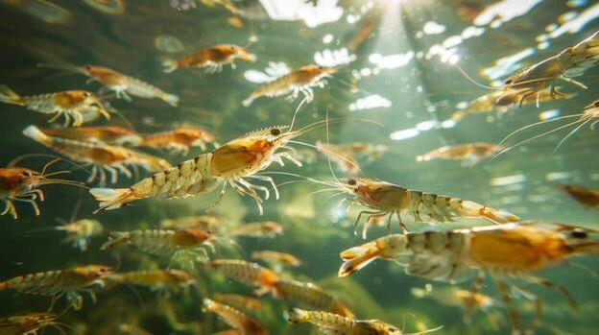
AQUAGUARD – Aquaculture Smart Monitoring System

Slide 2
Project Title:
Aqua Guard – IoT Based Water Quality Monitoring for Shrimp Farming.
Scenario:
Monitor water quality parameters in shrimp ponds and trigger alerts when conditions become unsafe.

Slide 3
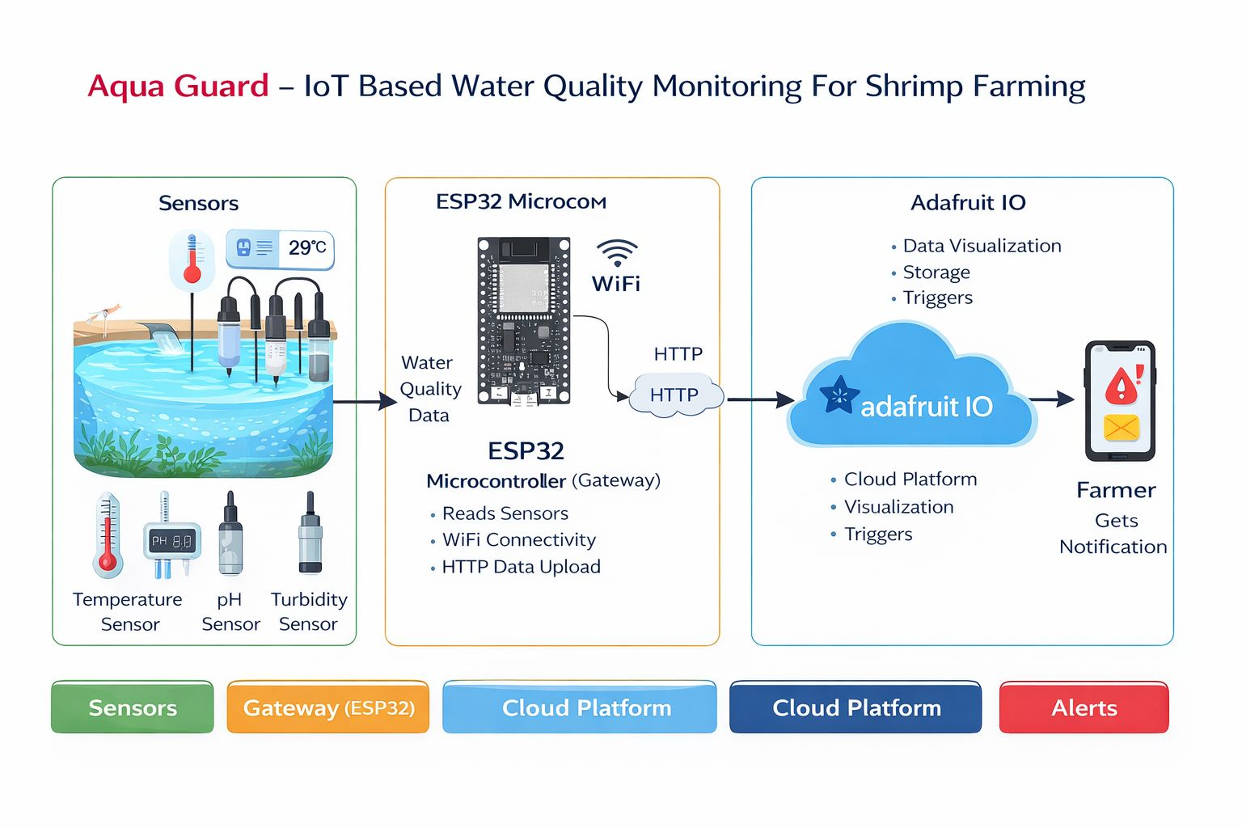
System Architecture

Slide 4
System Architecture Overview:
The Aqua Guard system consists of three main layers:
Sensor Layer – Collects real-time water parameters
Gateway Layer – ESP32 processes and sends data
Cloud Layer – Adafruit IO stores and visualizes data
Alert Layer – IFTTT sends notifications to farmers
Flow:
Sensors → ESP32 Gateway → WiFi → Adafruit IO Cloud → IFTTT Alerts → Farmer Mobile

